Slide 1
AN ECLECTIC CLUB PRESENTATION
Nov. 27, 2014
"Black & Unknown Bards": Resistance, Religion & Romance from Antebellum to Harlem Renaissance.

Slide 2
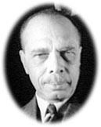
"O BLACK AND UNKNOWN BARDS“
From Poem title by James Weldon Johnson, 1871–1938
Young man—Young man—
Your arm’s too short to box with God.
—The Prodigal Son, God’s Trombones
James Weldon Johnson

Slide 3
"O BLACK AND UNKNOWN BARDS"
1
O BLACK and unknown bards of long ago,
How came your lips to touch the sacred fire?
How, in your darkness, did you come to know
The power and beauty of the minstrel’s lyre?
Who first from midst his bonds lifted his eyes?
Who first from out the still watch, lone and long,
Feeling the ancient faith of prophets rise
Within his dark-kept soul, burst into song?

Slide 4
2
Heart of what slave poured out such melody
As “Steal away to Jesus”? On its strains
His spirit must have nightly floated free,
Though still about his hands he felt his chains.
Who heard great “Jordan roll”? Whose starward eye
Saw chariot “swing low”? And who was he
That breathed that comforting, melodic sigh,
“Nobody knows de trouble I see”?

Slide 5
There is a wide, wide wonder in it all,
That from degraded rest and servile toil
The fiery spirit of the seer should call
These simple children of the sun and soil.
O black slave singers, gone, forgot, unfamed,
You—you alone, of all the long, long line
Of those who’ve sung untaught, unknown, unnamed,
Have stretched out upward, seeking the divine.
5

Slide 6
6
You sang not deeds of heroes or of kings;
No chant of bloody war, no exulting pean
Of arms-won triumphs; but your humble strings
You touched in chord with music empyrean.
You sting far better than you knew; the songs
That for your listeners’ hungry hearts sufficed
Still live,—but more than this to you belongs:
You sang a race from wood and stone to Christ.

Slide 7
THE ANTEBELLUM PERIOD

Slide 8
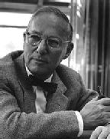
THE MYTH OF
THE NEGRO PAST (1941)
Melville Jean Herskovits, Ph.D.
(Columbia U.) September 10, 1895 –
February 25, 1963.
The son of Jewish immigrants. He was Professor and chair of Anthropology at Northwestern U.
As an American anthropologist he firmly established African and African-American studies in American academia.

Slide 9
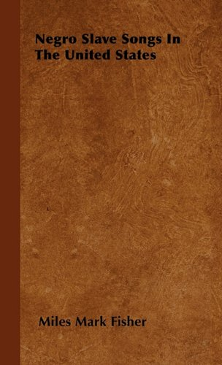
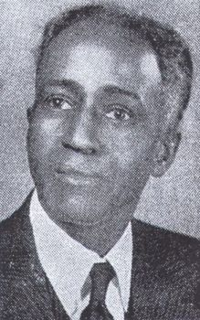
Rev. Mark Miles Fisher, Ph.D. (1899-1970) Baptist Pastor and Professor, Shaw U.
Published “Negro Slave….” 1953

Slide 10
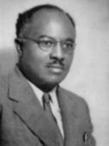
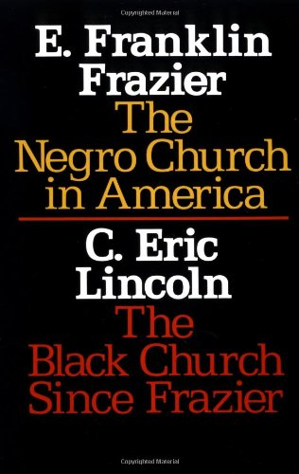
E. Franklin Frazier, Ph.D.
(University of Chicago)
(Born September 24, 1894 –
Died May 17, 1962).
Published “Negro Church” 1963
Taught at Morehouse, Fisk and Howard;
Founded School of Social Work at Atlanta U.

Slide 11
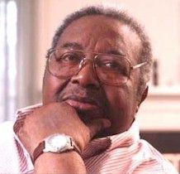
C. Eric Lincoln, PhD.
(June 23, 1924–
May 14, 2000).
Professor at Duke U.

Slide 12
THE ANTEBELLUM PERIOD
The Negro Spirituals
1) Singing as an expression of democratic values and community solidarity;
2) Singing as a source of inspiration and motivation;
3) Singing as an expression of protest; and
4) Singing as coded communication.

Slide 13
ALL GOD'S CHILLUN GOT WINGS
AIN’T GOT TIME TO DIE
BABYLON’S FALLING
DIDN’T MY LORD DELIBER DANIEL?
DIDN’T IT RAIN?
FOLLOW THE DRINK’N GOURD
GO DOWN MOSES
HEAV’N, HEAV’N
I’VE BEEN ‘BUKED AND I’VE BEEN SCORNED
I ‘M BOUND FOR THE PROMISE LAND
JOSHUA FIT THE BATTLE OF JERICHO
MY LORD, WHAT A MORNING
NOBODY KNOWS DE TROUBLE I'VE SEEN
O MARY DON'T YOU WEEP DON'T YOU MOURN
O FREEDOM
STEAL AWAY TO JESUS
WADE IN THE WATER, CHILDREN

Slide 14
Examples of Spirituals become Freedom/Protest Songs during Civil Rights Era
I WOKE UP THIS MORNING WITH A MIND STAYED ON JESUS (ON FREEDOM)
DON’T LET NO BODY TURN YOU (ME) AROUND
GO TELL IT ON THE MOUNTAIN THAT JESUS CHRIST WAS BORN (TO LET MY PEOPLE GO)
KEEP YOU HANDS ON THE PLOW, HOLD ON (KEEP YOU EYES ON THE PRIZE, HOLD ON}
OVER MY HEAD, I SESE JESUS IN THE AIR…THERE MUST BE A GOD SOMEWHERE (I SEE FREEDOM IN THE AIR)
Songs like O FREEDOM and THIS LITTLE LIGHT OF MINE remained the same.

Slide 15
Poets and Pamphleteers

Slide 16
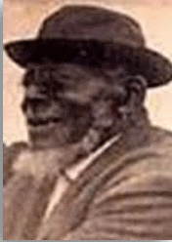
Poets and Pamphleteers
Jupiter Hammon (October 17, 1711 – before 1806)
was a black poet who in 1761 became the first
African-American writer to be published in the
present-day United States.

Slide 17
Poets and Pamphleteers
Jupiter Hammon (October 17, 1711 – before 1806)
was a black poet who in 1761 became the first
African-American writer to be published in the
present-day United States.
First known African-American published author:
Jupiter Hammon (poem "An Evening Thought: Salvation by Christ
with Penitential Cries", published as a broadside).
Additional poems and sermons were also published.

Slide 18
Poets and Pamphleteers
Jupiter Hammon (October 17, 1711 – before 1806)
was a black poet who in 1761 became the first
African-American writer to be published in the
present-day United States.
First known African-American published author:
Jupiter Hammon (poem "An Evening Thought: Salvation by Christ
with Penitential Cries", published as a broadside).
Additional poems and sermons were also published.
Born into slavery, Hammon was never emancipated.
He was living in 1790 at the age of 79, and died by 1806.
A devout Christian, he is considered one of the
founders of African-American literature.

Slide 19
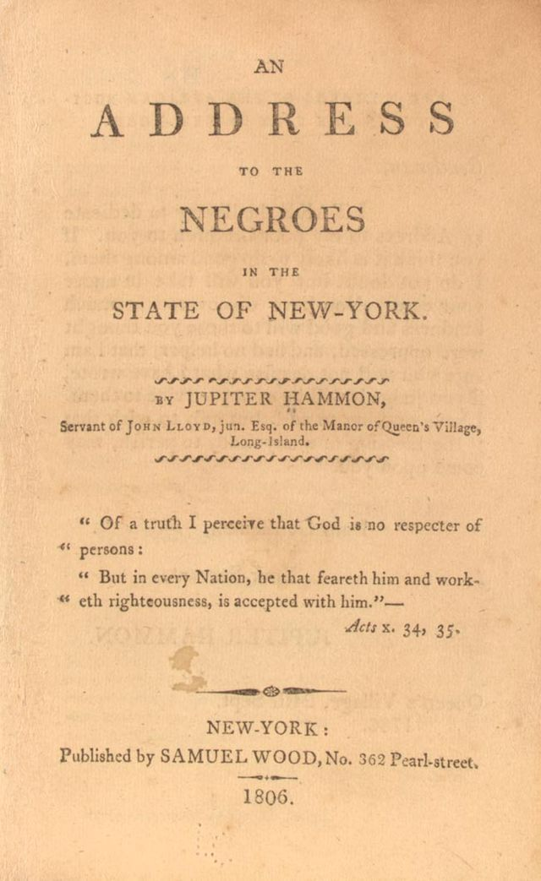
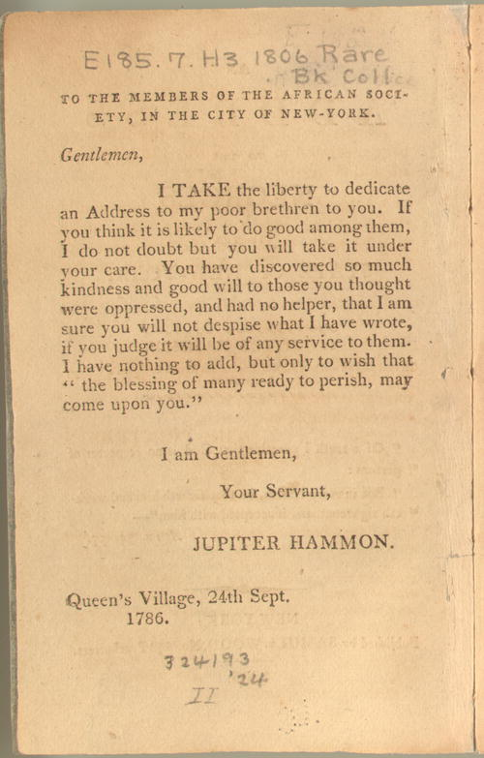

Slide 20
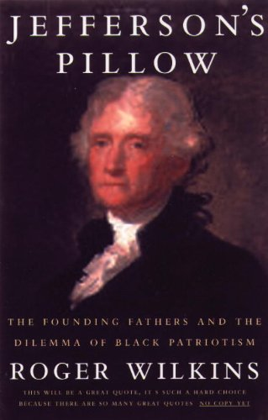

Slide 21
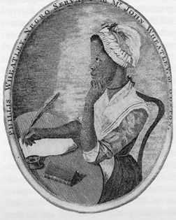
Phyllis Wheatley, ca.1753-1784

Slide 22
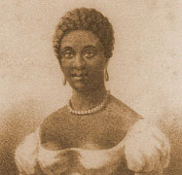
A rare portrait of Phillis Wheatley shows her facing forward, wearing an evening dress and jewelry. The portrait appeared in Revue des Colonies in Paris between 1834 and 1842.
Her collection, Poems on Various Subjects, Religious and Moral, was published on September 1, 1773

Slide 23
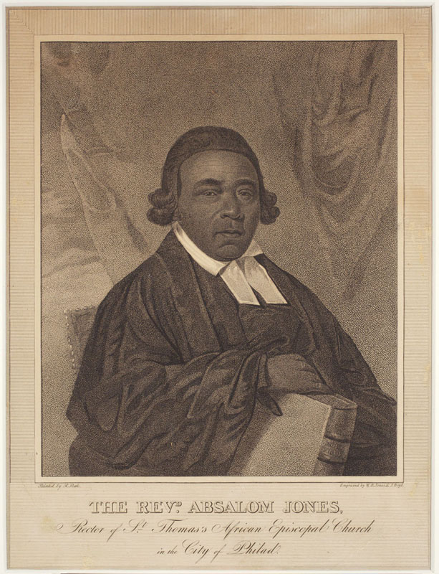
The Revd.
Absalom Jones,
Rector of St. Thomas’s
African Episcopal
Church in the City of
Philadelphia.
Stipple engraving by
W. R. Jones & John Boyd,
after the oil painting by
Rembrandt Peale
Philadelphia, ca. 1820).
Courtesy of Mother Bethel Church.

Slide 24
A Thanksgiving Sermon,
preached January 1, 1808,
in St. Thomas's, or the
African Episcopal, Church, Philadelphia: On Account of the Abolition
of the African slave trade,
on that day, by the
Congress of the United States.
Philadelphia: Fry and Kammerer, 1808.

Slide 25
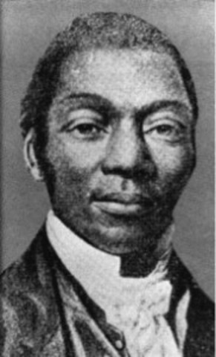
David Walker Pamphleteer
“The Black Thomas Paine”
Born: September 27, 1796,
Cape Fear, NC
Died: June 28, 1830, Boston, MA
David Walker was an outspoken African-American
abolitionist and anti-slavery activist.
In 1829, while living in Boston, Massachusetts, he
published An Appeal to the Coloured Citizens of the World

Slide 26
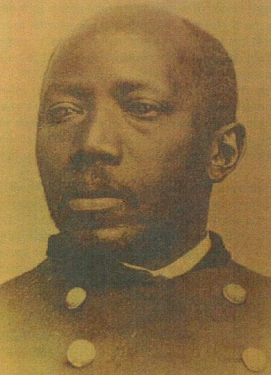
George Moses Horton
The first
African American
poet to be
published in
the Southern
United States.

Slide 27
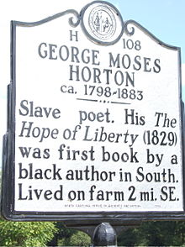
Born: 1779, North Carolina. Died: 1883
Education: University of North Carolina
at Chapel Hill
Books:
The Black bard of
North Carolina,
Naked Genius

Slide 28
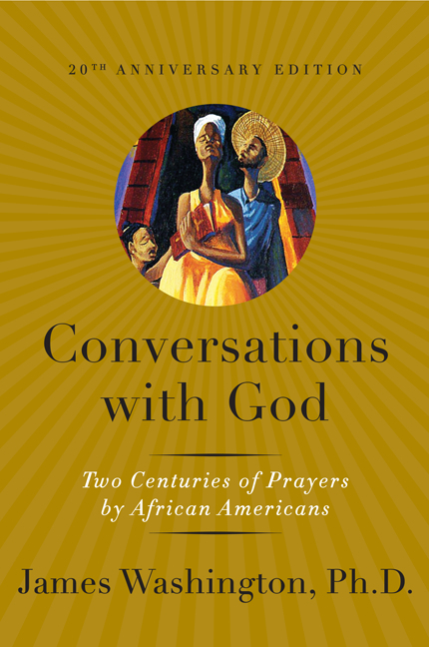

Slide 29
“JIM CROW” PERIOD:
THE WAR YEARS
AND THE
HARLEM RENAISSANCE

Slide 30
Some Stars of the Period…
Paul Lawrence Dunbar
(Sympathy--the Caged Bird Sings, Love Song);
J.W. Johnson (Black and Unknown Bards,
Lift Every Voice and Sing);
Langston Hughes (Cross, Dream Deferred);
Countee Cullen (Heritage, Yet Do I Marvel);

Slide 31
Some Lesser Known Stars…
Frank Horne (2 Catholic Boys)
Gwendolyn Bennett (The Crisis and Opportunity)
Zora Neale Hurston (Their Eyes were Watching God)
Billie Holiday & Abel Meeropol (Strange Fruit)

Slide 32
Some Harrisburg Connections
to the Legacy
Beatrice M. Murphy (1908 – 1992)
Belgium Nathan Baxter (1923 – 1995)

Slide 33
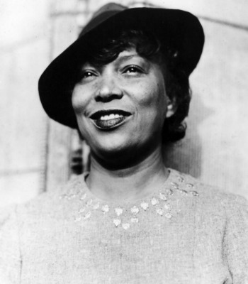
Zora Neale Hurston
1891 (Alabama) 1960 (Florida)

Slide 34
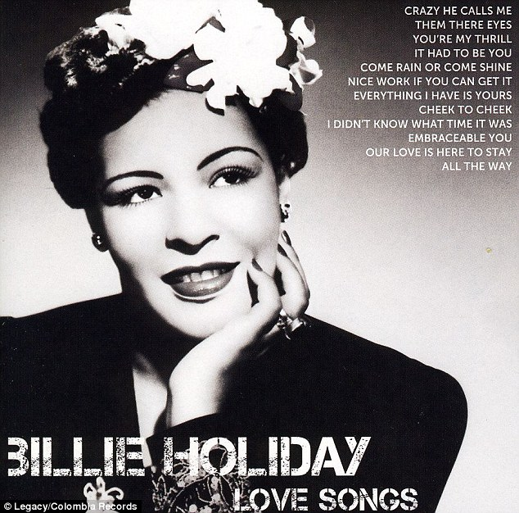
Strange
Fruit
By Billie Holiday and Abel Meeropol (1937)

Slide 35
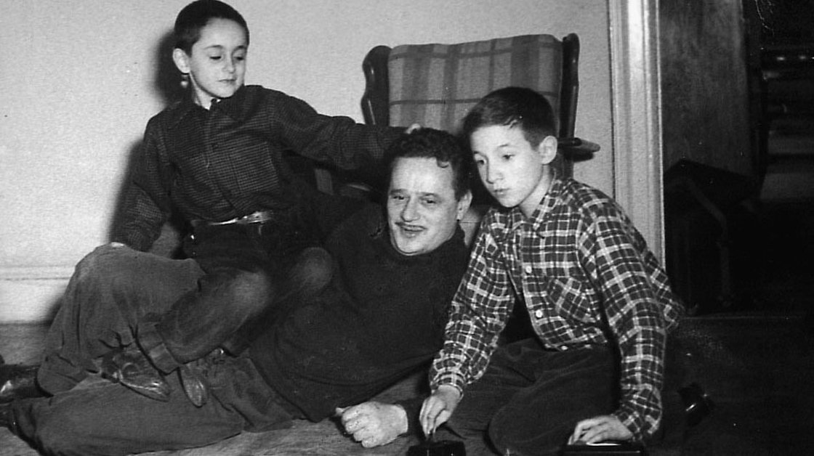
Abel Meeropol (1903-1986)
An American writer, teacher and song-writer,
best known under his pseudonym Lewis Allan and
as the adoptive father of the young sons of
Julius and Ethel Rosenberg.

Slide 36
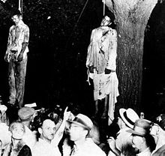
Meeropol cited this photograph of the lynching
of Thomas Shipp
and Abram Smith,
August 7, 1930,
as inspiring
his poem.

Slide 37
Strange Fruit By Billie Holiday and Abel Meeropol (1937)
Southern trees bear strange fruit, Blood on the leaves and blood at the root, Black bodies swinging in the southern breeze, Strange fruit hanging from the poplar trees. Pastoral scene of the gallant south, The bulging eyes and the twisted mouth, Scent of magnolias, sweet and fresh, Then the sudden smell of burning flesh. Here is fruit for the crows to pluck, For the rain to gather, for the wind to suck, For the sun to rot, for the trees to drop, Here is a strange and bitter crop.

Slide 38
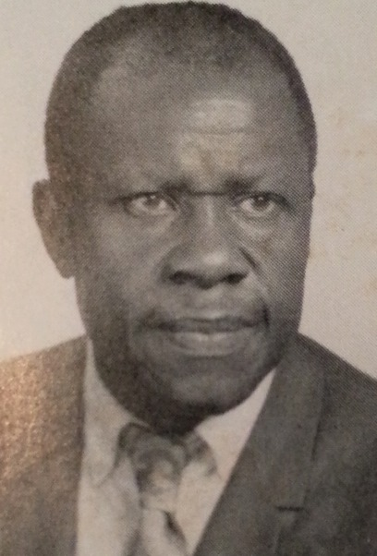
The Vicissiudes of Man
1970
by Reverend Belgium N. Baxter
Preface by the
Honorable C. Delores Tucker.

Slide 39
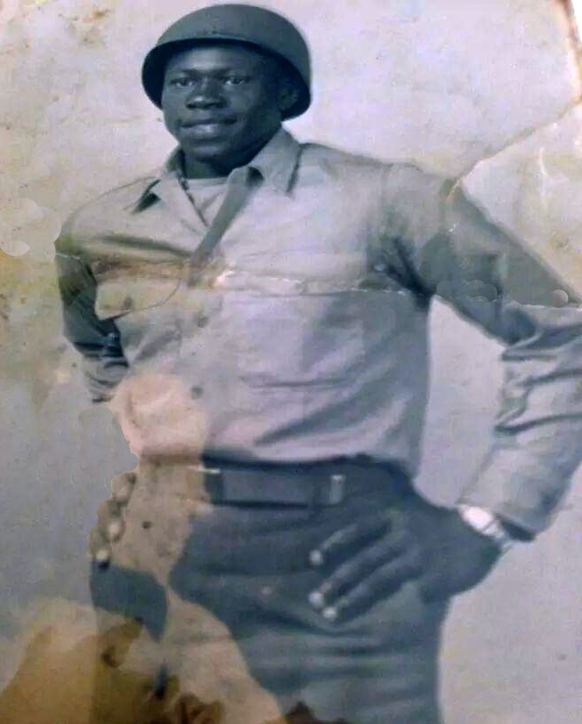
Circa 1944
In Memoriam – F.D.R.
Guard Post
I can Tell the World

Slide 40
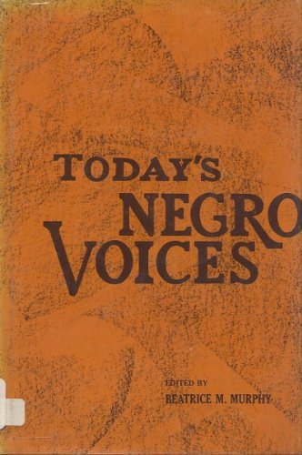
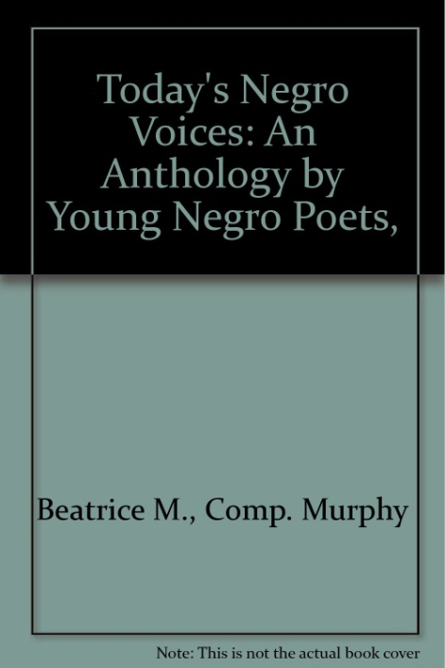
Beatrice M. Murphy (1908–1992), poet, editor,
columnist, and reviewer.
Born in Monessen, Pennsylvania,
Beatrice Murphy lived most of her life in
Washington, D.C. In 1928 she graduated from
Dunbar High School and published her first poem

Slide 41
The Letter
Beatrice M Murphy
Please excuse this letter;
I know we said we're through,
But there's something very precious
Of mine you took with you
And I must have it back.
I'm sure that you will find it
If you search among your pack
Way down in the innermost part.
Please wrap it carefully
Before you mail - -
You see, it is my heart.

Slide 42
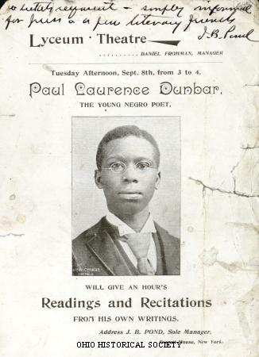
A Negro Love Song by Paul Laurence Dunbar (1872–1906)
SEEN my lady home las’ night,
Jump back, honey, jump back.
Hel’ huh han’ an’ sque’z it tight,
Jump back, honey, jump back.
Hyeahd huh sigh a little sigh,
Seen a light gleam f’om huh eye,
An’ a smile go flittin’ by—
Jump back, honey, jump back.

Slide 43
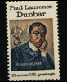
Hyeahd de win’ blow thoo de pine,
Jump back, honey, jump back.
Mockin’-bird was singin’ fine,
Jump back, honey, jump back.

Slide 44
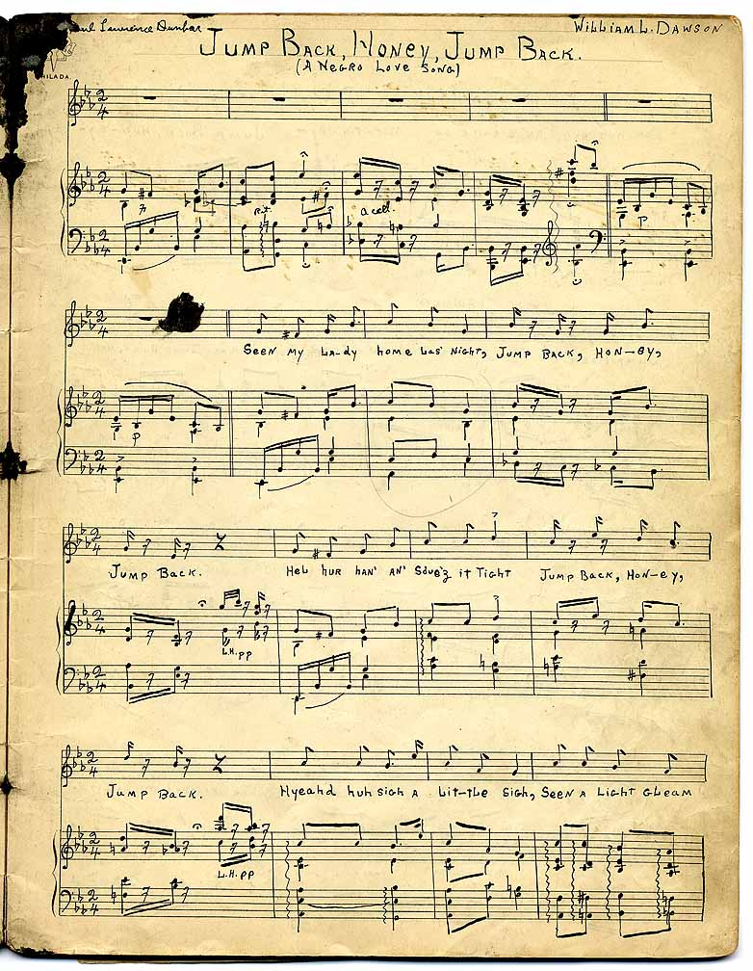
An’ my hea’t was beatin’ so,
When I reached my lady’s do’,
Dat I could n’t ba’ to go—
Jump back, honey, jump back.

Slide 45
Put my ahm aroun’ huh wais’,
Jump back, honey, jump back.
Raised huh lips an’ took a tase,
Jump back, honey, jump back.
Love me, honey, love me true?
Love me well ez I love you?
An’ she answe’d, “Cose I do”—
Jump back, honey, jump back!!!

Slide 46
Time for Comment…

